Slide 1
FHIM MDA Implementation Modeling Process Guide
Developing Standard-specific Implementation Guide for Health IT
Part 2 - Demonstration

Slide 2
FHIM Implementation Demonstration
Follow up to the September 12th webinar
Model-driven approach
The model is the basis for generating
Ballot documentation
Software libraries for creating/parsing, validating constraints
Reference implementation (i.e. Java API)
Modeling implementation guides based on interoperability use cases
One IG model may be used to create multiple Platform-specific IG artifacts
NIEM-based IEPD
CDA R2 IG → Example provided in this presentation
HL7 FHIR Profiles

Slide 3
Questions Discussion
Implementation Guide Modeling for a project-specific Implementation Guide based on HL7 CDA R2
Code generation
Document/ballot generation

Slide 4
Implementation Guide Development
Step-by-step demonstration
Reuse of information modeling and terminology (bindings)
Data constraints
Value set/code system/fixed value constraints

Slide 5
How to…
Start with project-specific requirements
State-based immunization registration
Select the FHIM domain
Immunization
Identify focal classes and referenced classes
Identify value set bindings
Copy/clone the relevant classes and terminology
State Immunization Registry UML model

Slide 6
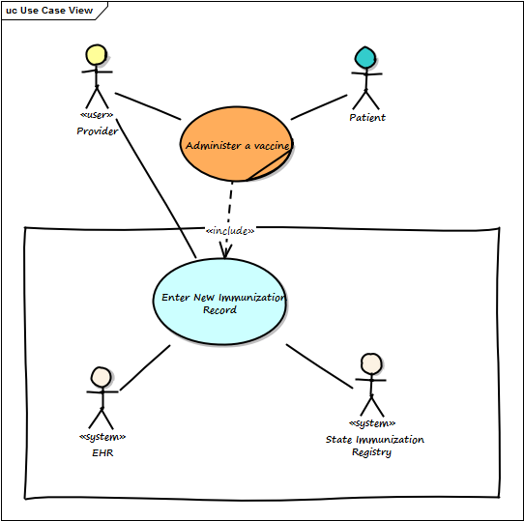
State Registry Use Case Analysis
State-specific
Requirements
- Funding source

Slide 7
Apply project constraints…
Using the newly created UML model create your standard-neutral Implementation Guide (IG) model
Constrain cardinality further, if needed
Constrain data types, if needed
Fix coded values, if needed
Create sub-sets from existing value sets and bind them to appropriate coded attributes in the IG model classes

Slide 8
Model Driven Health Tools (MDHT)
FHIM contents/public project:
FHIM (fhim.org) → View Model
MDHT Tools
https://www.projects.openhealthtools.org/sf/projects/mdht/

Slide 9
Benefits of Model-Driven Approach
Analyze once implement many times
Maintain all your project constraints and improve them over time rather than starting “from scratch” if a new standard is needed
Consistent with FHIM/Federal Guideline
Your IG model may be reused in the future for other interoperability standards IGs
Allows for transition from one information exchange format to another
E.g. HL7 Version 2 to FHIR

